Slide 1
dbms
Module 4 part 1

Slide 2
index
Normalization
Functional dependency
Armstrong’s Axioms
Closure Of Functional Dependency
Equivalence of Functional Dependencies
Minimal Cover

Slide 3
normalization
Normalization is the process of organizing the data in the database
It is used to minimize the redundancy from a relation or set of relations
It is also used to eliminate the insertion anomaly,update anomaly and deletion anomaly
It divides the larger table into the smaller table and links them using relationship

Slide 4
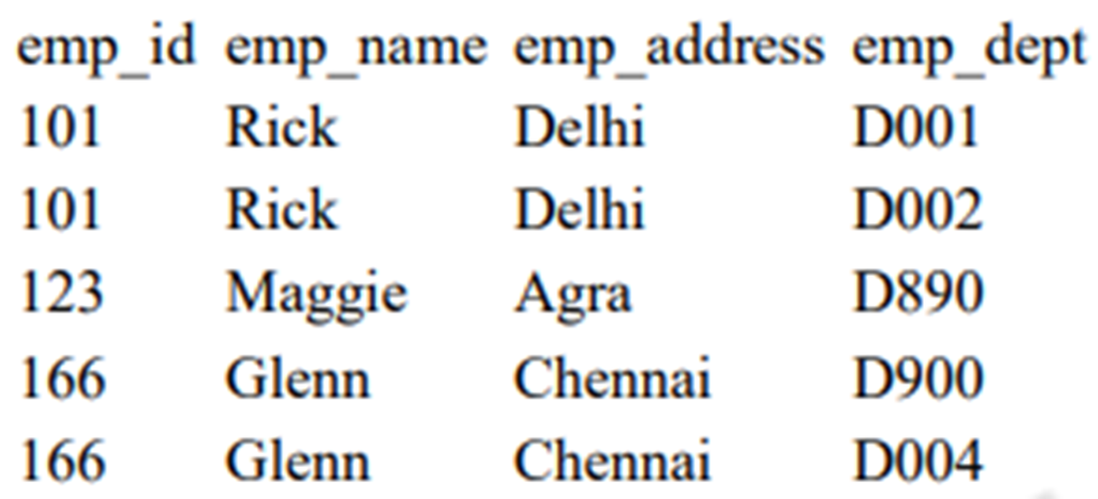
Update anomalies
Deletion anomalies
Insert anomalies

Slide 5
Functional dependency
A functional dependency is an association between two attributes of the same relational database table.
One of the attributes is called the determinant and the other attribute is called the determined
If A is the determinant and B is the determined then we say that A functionally determines B and graphically represent this as A -> B

Slide 6
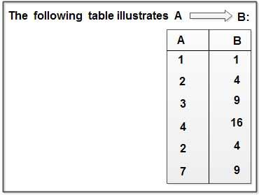
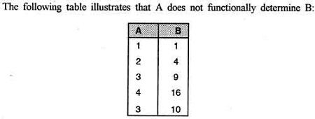

Slide 7
Armstrong’s Axioms
Armstrong’s Axiom is a mathematical notation used to find the functional dependencies in a database.
Conceived by William W. Armstrong
It is a list of axioms or inference rules that can be implemented on any relational database.
It is denoted by the symbol F+.

Slide 8
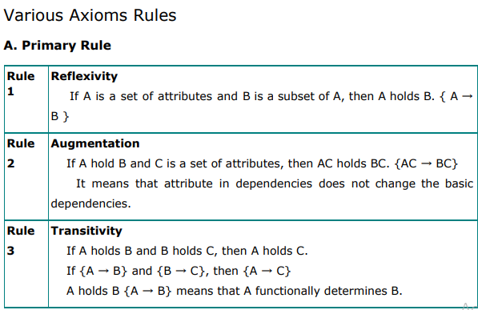

Slide 9
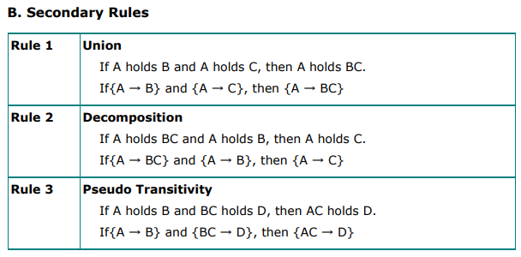

Slide 10
Closure Of Functional Dependency
The Closure Of Functional Dependency means the complete set of all possible attributes that can be functionally derived from given functional dependency
● If “F” is a functional dependency then closure of functional dependency can be denoted using “{F}+ ”.
● There are three steps to calculate closure of functional dependency

Slide 11
Step-1 : Add the attributes which are present on Left Hand Side in the original functional dependency.
Step-2 : Now, add the attributes present on the Right Hand Side of the functional dependency.
Step-3 : With the help of attributes present on Right Hand Side, check the other attributes that can be derived from the other given functional dependencies. Repeat this process until all the possible attributes which can be derived are added in the closure.

Slide 12
Example:
Consider the table student_details having (Roll_No, Name,Marks, Location) as the attributes and having two functional dependencies.
FD1 : Roll_No -> Name, Marks
FD2 : Name -> Marks, Location
Step-1: {Roll_no}+ = {Roll_No}
Step-2 : {Roll_no}+ = {Roll_No,Name, Marks}
Step-3 : {Roll_no}+ = {Roll_No, Marks, Name, Location}
Step-1 : {Name}+ = {Name}
Step-2 : {Name}+ = {Name, Marks, Location}
Step-3 : Since, we don’t have any functional dependency where “Marks or Location”. So {Name}+ = {Name, Marks, Location}
{Marks}+ = {Marks} and {Location}+ = { Location}

Slide 13
Equivalence of Functional Dependencies (FD)
Two different sets of functional dependencies for a given relation may or may not be equivalent.
● If FD1 can be derived from FD2, we can say that FD2 ⊃ FD1.
● If FD2 can be derived from FD1, we can say that FD1 ⊃ FD2.
● If above two cases are true, FD1=FD2.

Slide 14
Eg:A relation R(A,B,C,D) having two FD sets FD1 = {A->B, B->C, AB->D} and FD2 = {A->B, B->C, A->C, A->D}
Step 1. Checking whether all FDs of FD1 are present in FD2
● A->B YES
● B->C YES
● AB->D YES For set FD2, (AB)+ = {A,B,C,D}.
FD2 ⊃ FD1 is true.
Step 2. Checking whether all FDs of FD2 are present in FD1
● A->B YES
● B->C YES
● A->C YES For set FD1, (A)+ = {A,B,C,D}.
● A->D YES For set FD1, (A)+ = {A,B,C,D}
FD1 ⊃ FD2 is true.
Step 3. As FD2 ⊃ FD1 and FD1 ⊃ FD2 both are true FD2 =FD1 is true. These two FD sets are semantically equivalent.

Slide 15
Minimal Cover
Whenever a user updates the database, the system must check whether any of the functional dependencies are getting violated in this process. If there is a violation of dependencies in the new database state, the system must roll back. Working with a huge set of functional dependencies can cause unnecessary added computational time. This is where the minimal cover comes into play.
There are 4 rules to find Minimal cover :
1. Break down the RHS of each functional dependency into a single attribute
2. Find redundant fds
3. Minimize LHS.
4. Group the functional dependencies that have common LHS together into a Single FD .

Slide 16
Q1. Minimal cover of F with dependencies F={BC->ADEF, F->DE} ?
STEP 1: Break down the RHS
BC->A BC->D BC->E BC->F F->D F->E
STEP 2: Find redundant fds
● Assume BC->A is redundant fd and we remove this fd,now try computing (BC)+={BCDEF} but there is no A. so BC->A is not redundant
●BC->D (BC)+={BCAEFD}, D is present so BC->D is redundant
● BC->E (BC)+={BCADFE}, E is present so BC->E is redundant
● BC->F (BC)+={BCADE}, F is not present so BC->F is not redundant
so we get
BC->A BC->F F->D F->E

Slide 17
BC->A BC->F F->D F->E
STEP 3: Minimize LHS
BC->A BC->F
● From BC-> A, if we remove B and then we get C->A. By taking closure (C)+={C,A}, there is no B. same way remove C then B->A. By taking closure there is no C. So it can’t be minimize
● BC->F ,it also can’t be minimize
so we get
BC->A BC->F F->D F->E
Step 4: Group the functional dependencies that have common LHS together into a Single FD .
so the minimal cover is
BC->A F F->DE

Slide 18
THANK YOU

Slide 19
dbms
Module 4 part 2

Slide 20
index
First Normal Form (1NF)
Second Normal Form (2NF)
Third Normal Form (3NF)
Boyce Codd Normal Form (BCNF)

Slide 21
normalization
Normalization is the process of organizing the data in the database
It is used to minimize the redundancy from a relation or set of relations
It is also used to eliminate the insertion anomaly,update anomaly and deletion anomaly
It divides the larger table into the smaller table and links them using relationship

Slide 22
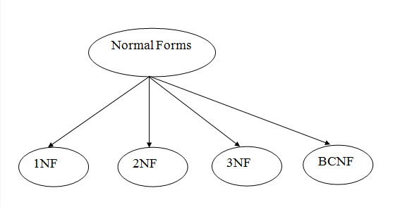

Slide 23
First Normal Form (1NF)
A relation will be 1NF if it contains an atomic value.
It states that an attribute of a table cannot hold multiple values. It must hold only single-valued attribute.

Slide 24
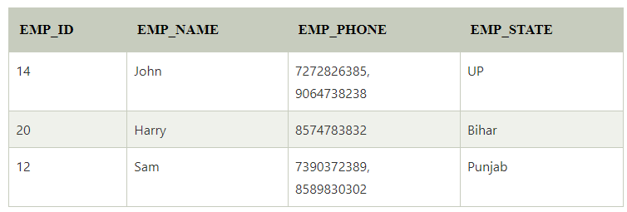
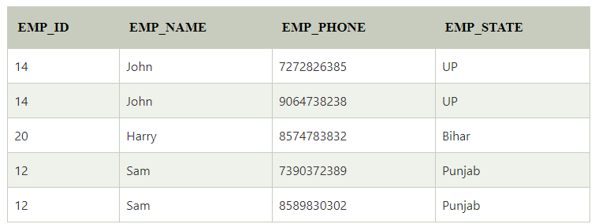

Slide 25
Second Normal Form (2NF)
In the 2NF, relational must be in 1NF.
In the second normal form, No non-prime attribute is dependent on the proper subset of any candidate key of table
Non-prime attribute: An attribute that is not a part of any candidate key

Slide 26




Slide 27
Third Normal Form (3NF)
In 3NF,the relation must be in 2NF
Transitive functional dependency of non-prime attribute on any super key should be removed
Transitive functional dependency: A->B & B->C ,THEN A->C

Slide 28
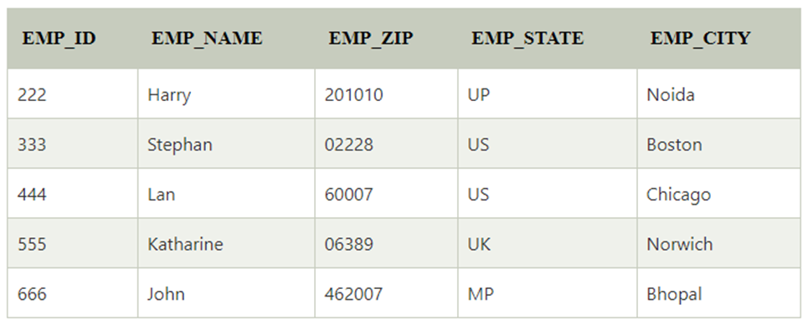
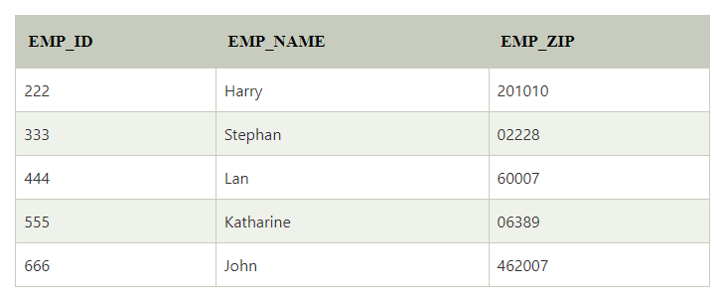
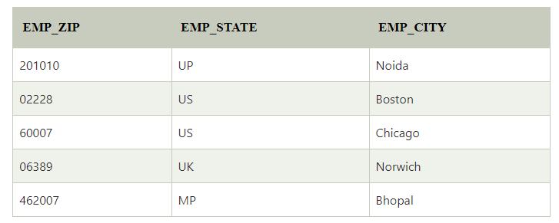
Super key in the table above:
{EMP_ID}, {EMP_ID, EMP_NAME}, {EMP_ID, EMP_NAME, EMP_ZIP}....so on
Candidate key: {EMP_ID}
Non-prime attributes: In the given table, all attributes except EMP_ID are non-prime

Slide 29
Boyce Codd Normal Form (BCNF)
BCNF is the advance version of 3NF.
A table is in BCNF if every functional dependency X → Y, X is the super key of the table.

Slide 30
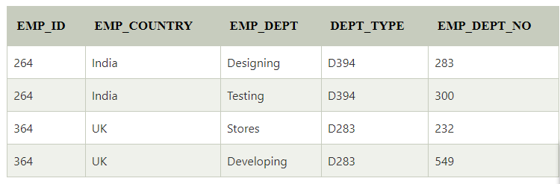
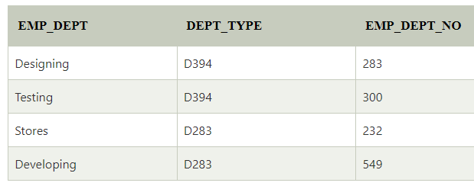

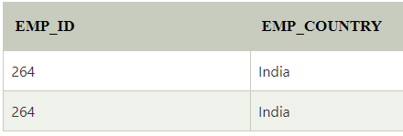
In the above table Functional dependencies are as follows:
EMP_ID → EMP_COUNTRY
EMP_DEPT → {DEPT_TYPE, EMP_DEPT_NO}
Candidate key: {EMP-ID, EMP-DEPT}

Slide 31
THANK YOU

Slide 32
dbms
Module 4 part 3

Slide 33
index
Lossless join and dependency preserving decomposition
Algorithms for checking Lossless Join (LJ)

Slide 34
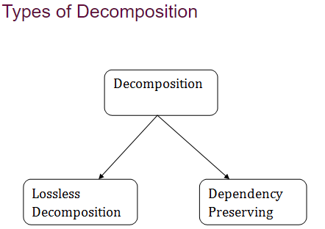
Lossless join and dependency preserving decomposition
Decomposition of a relation is done when a relation in relational model is not in appropriate normal form.
Relation R is decomposed into two or more relations if decomposition is lossless join as well as dependency preserving.

Slide 35
Lossless Join Decomposition
If the information is not lost from the relation that is decomposed, then the decomposition will be lossless.
ie, the relation is said to be lossless decomposition if natural joins of all the decomposition give the original relation.
If we decompose a relation R into relations R1 and R2
1. Decomposition is lossy if R1 ⋈ R2 is not R
2. Decomposition is lossless if R1 ⋈ R2 is equal to R

Slide 36
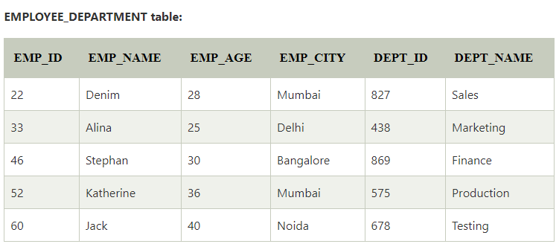
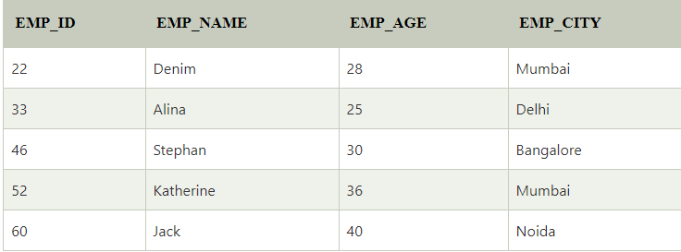
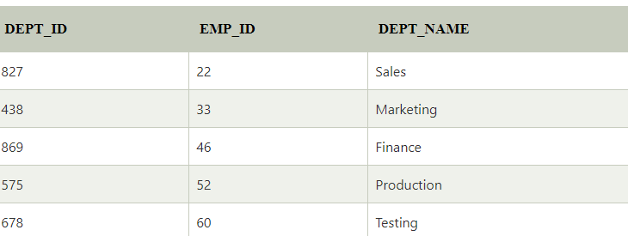
⋈
Employee
Department

Slide 37
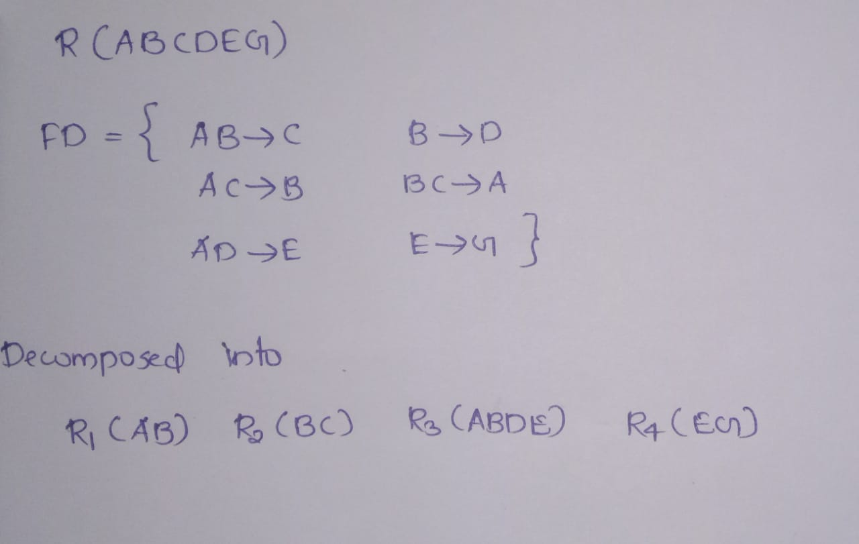
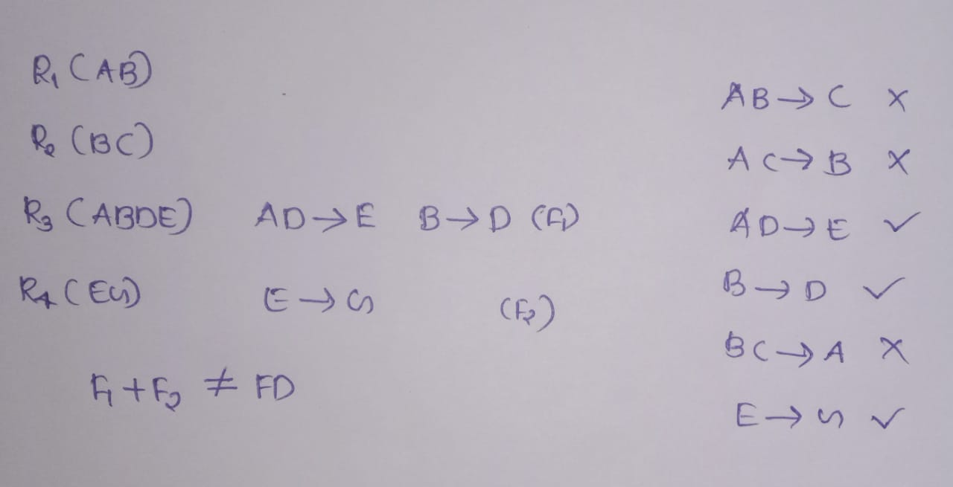
Dependency Preserving Decomposition
The dependency preservation property, which ensures that each functional dependency is represented in some individual relation resulting after decomposition
In the dependency preservation, at least one decomposed table must satisfy every dependency.

Slide 38
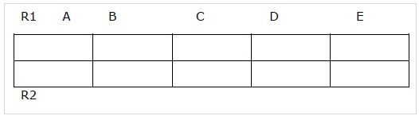
Algorithms for checking Lossless Join (LJ)
R(A,B,C,D,E)
F:{A->B, BC->E, ED->A}
R is decomposed into R1(AB) and R2(ACDE)
Step 1 − Create a table with M rows and N columns
M= number of decomposed relations.
N= number of attributes of original relation.

Slide 39
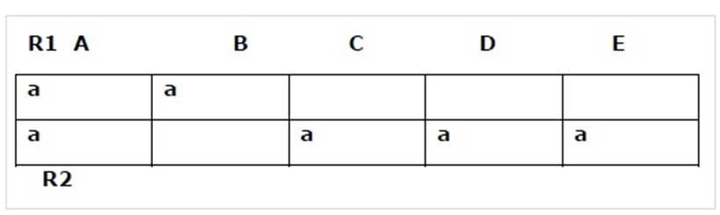
Step 2 − If a decomposed relation Ri has attribute A then
Insert a symbol (say ‘a’) at position (Ri,A)

Slide 40
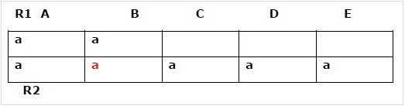
Step 3 − Consider each FD X->Y
If column X has two or more symbols then
Insert symbols in the same place (rows) of column Y.
Now let us insert symbol ‘a’ for A->B in second column, second row
Step 4 − If any row is completely filled with symbols then
Decomposition is lossless.
Else R2 is completely filled => decomposition is lossless.
Decomposition is lossy.

Slide 41
THANK YOU

